Slide 1


Nataliia Lauria
Apr 21, 2024

Slide 2

Outline
Executive Summary
Introduction
Methodology
Results
Conclusion
Appendix

Slide 3
Executive Summary
Summary of methodologies
-Data Collection through API
-Data Collection with Web Scraping
-Data Wrangling
-Exploratory Data Analysis with SQL
-Exploratory Data Analysis with Data Visualization
-Interactive Visual Analytics with Folium
-Machine Learning Prediction
•Summary of all results
-Exploratory Data Analysis result
-Interactive analytics in screenshots
-Predictive Analytics result

Slide 4
Introduction
Project background and context
SpaceX advertises Falcon 9 rocket launches on its website with a cost of 62 million dollars; other providers cost upward of 165 million dollars each, much of the savings is because SpaceX can reuse the first stage. Therefore if we can determine if the first stage will land, we can determine the cost of a launch. This information can be used if an alternate company wants to bid against SpaceX for a rocket launch. In this lab, you will collect and make sure the data is in the correct format from an API. The following is an example of a successful and launch.
•Problems you want to find answers
-What factors determine if the rocket will land successfully?
-The interaction amongst various features that determine the success rate
of a successful landing.
-What operating conditions needs to be in place to ensure a successful
landing program.

Slide 5

Section 1

Slide 6
Methodology
Executive Summary
Data collection methodology:
Source: The data was collecter from the SpaceX API.
Perform data wrangling
Cleaning the data to remove any inconsistencies or null values.
Structuring the data into a format suitable for analysis.
Perform exploratory data analysis (EDA) using visualization and SQL
Perform interactive visual analytics using Folium and Plotly Dash
Perform predictive analysis using classification models
How to build, tune, evaluate classification models

Slide 7
Data Collection
SpaceX API
- API calls were made to SpaceX’s endpoints.
- Responses from theses calls provided JSON-formatted data.
- Normalize JSON formatted data
- Creating a data frame
- Filter and cleaning the data
Web Scrapping from Wikipedia
- Using Python libraries such as BeautifulSoup.
- The HTML content was parsed and required information extracted into tables

Slide 8
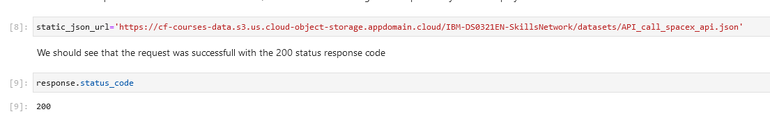
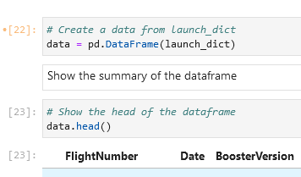
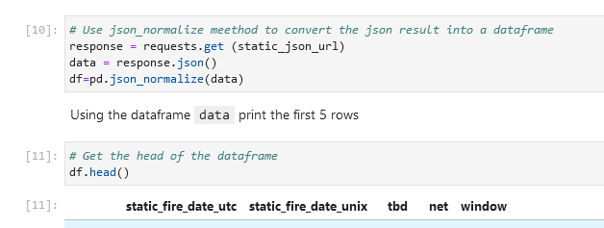
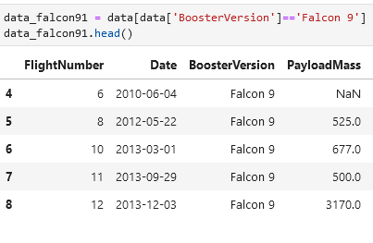
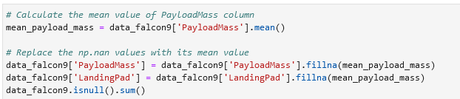
Data Collection – SpaceX API
https://github.com/natfili01/IBM_data-_project/blob/main/jupyter-labs-spacex-data-collection-api(2).ipynb
API calls were made to SpaceX’s endpoints.
Creating a data frame
Normalize JSON formatted data
Filter and cleaning the data

Slide 9
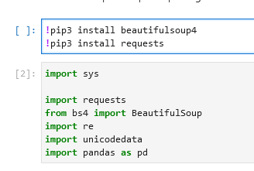
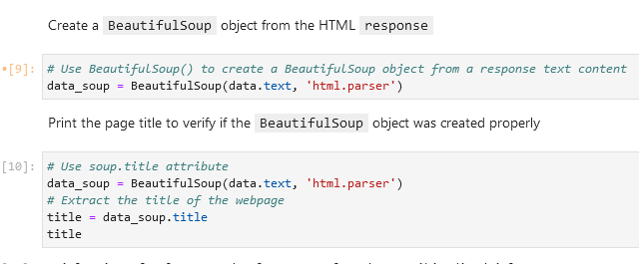
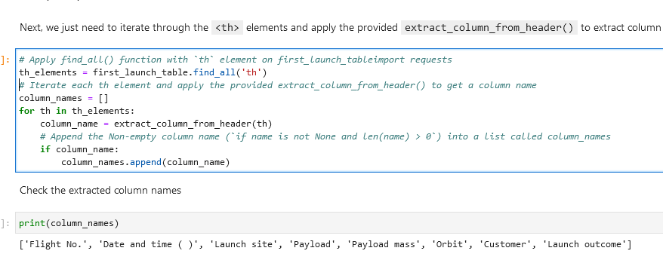
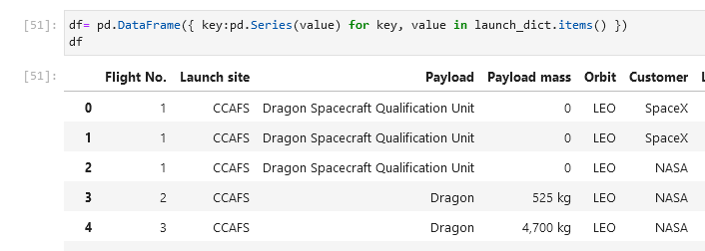
Data Collection - Scraping
Import libraries for fetching webpage and BeautifulSoup for parsing HTML
Pace the data and create a data frame
https://github.com/natfili01/IBM_data-_project/blob/main/jupyter-labs-webscraping.ipynb
Import packages
Create a BeautifulSoup object
Extract column names
Create a data frame

Slide 10
Data Wrangling
Perform EDA
Load Space X dataset, identify and calculate the percentage of the missing values in each attribute, Calculate the number of launches on each site
Calculate the number and occurrences of mission outcome of the orbits
Create a landing outcome label from Outcome column
https://github.com/natfili01/IBM_data-_project/blob/main/labs-jupyter-spacex-Data%20wrangling.ipynb

Slide 11
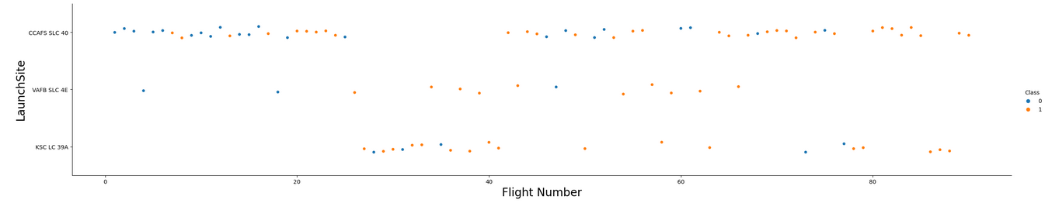
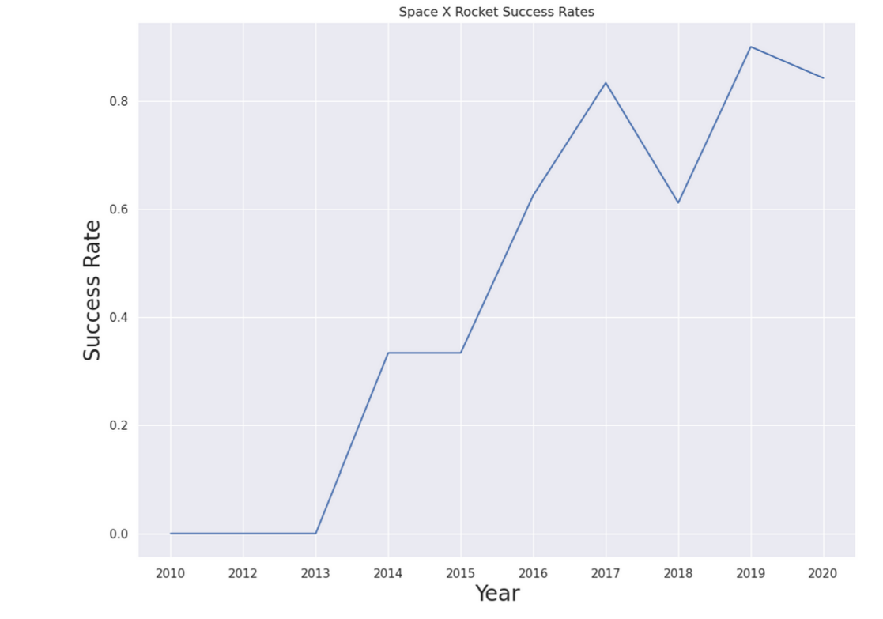
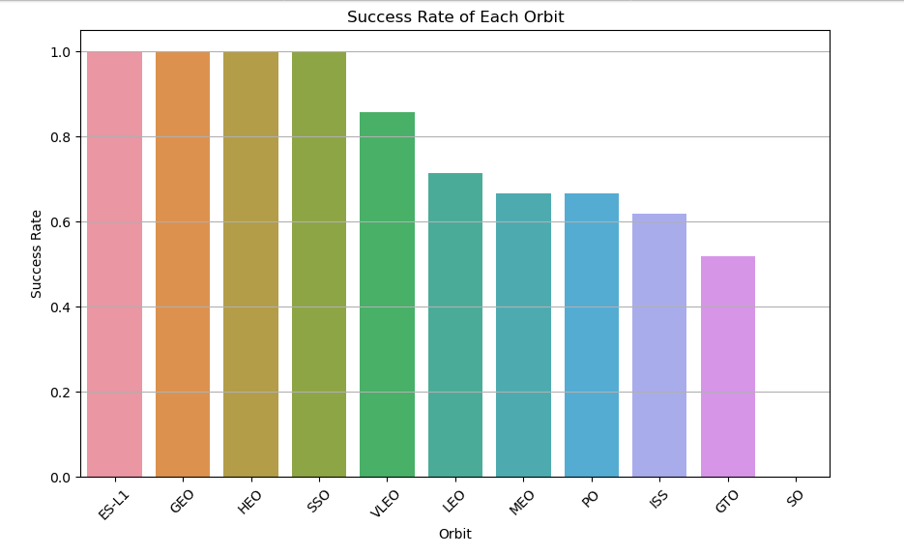
EDA with Data Visualization
Plotted charts provide insights into various aspects of the launch data:
- The relationship between flight number and launch site, which could indicate
- Success rates across different orbit types, helping to identify which orbits have higher success rates.
The overall trend of launch success over the years, providing insights into the reliability and progress of space launch activities.
https://github.com/natfili01/IBM_data-_project/blob/main/jupyter-labs-eda-dataviz(1).ipynb

Slide 12
EDA with SQL
Analyze key metrics and outcomes of space missions.
- Display unique launch sites in the space mission.
- List booster versions with the maximum payload mass.
- Rank landing outcomes between specified dates.
- Calculate total payload mass carried by NASA (CRS) boosters.-
- Retrieve records with specific criteria such as payload mass and landing outcomes.
https://github.com/natfili01/IBM_data-_project/blob/main/jupyter-labs-eda-sql-coursera_sqllite(2).ipynb

Slide 13
Build an Interactive Map with Folium
Mark all launch sites on a map.
Mark success/failed launches for each site on the map.
Calculate distances between launch site and proximities.
Interactive visual analytics using Folium enables deeper insights into launch site locations.
Understanding geographical patterns aids in optimizing future launch site selection and operations.
Importance of Coastal and Airport Proximity
Coastline: Provides safety buffer for overwater launches, minimizing risks to populated areas.
Airport: Considerations for airspace management and coordination to ensure safe launch operations.
https://github.com/natfili01/IBM_data-_project/blob/main/lab_jupyter_launch_site_location(2).ipynb

Slide 14
Build a Dashboard with Plotly Dash
Plots Included:
Success Pie Chart:
This chart displays the proportion of successful launches at different launch sites or across all sites.
Purpose: Provides an immediate visual representation of success rates, making it easy to compare the effectiveness of different launch sites in terms of mission success.
Success-Payload Scatter Chart:
A scatter plot correlating the payload mass with the success of launches for different booster versions.
Purpose: Helps to analyze whether heavier payloads have a lower success rate and how different booster versions perform across various payload ranges.
Reasons for These Choices:
User Engagement
Data Exploration
Visual Appeal and Clarity
https://github.com/natfili01/IBM_data-_project/blob/main/Dash.ipynb

Slide 15
Predictive Analysis (Classification)
Collected and cleaned relevant data, then trained multiple classification models such as Decision Tree, SVM, KNN, and Logistic Regression.
After evaluating ML performance through cross-validation and metrics like accuracy, improved them by tuning hyperparameters and employing feature selection.
Finally, the model with the highest accuracy was selected as the best performing model for deployment.
https://github.com/natfili01/IBM_data-_project/blob/main/SpaceX_Machine%20Learning%20Prediction_Part_5.backup(1).ipynb

Slide 16
Results
Exploratory data analysis results
Interactive analytics demo in screenshots
Predictive analysis results

Slide 17

Section 2

Slide 18
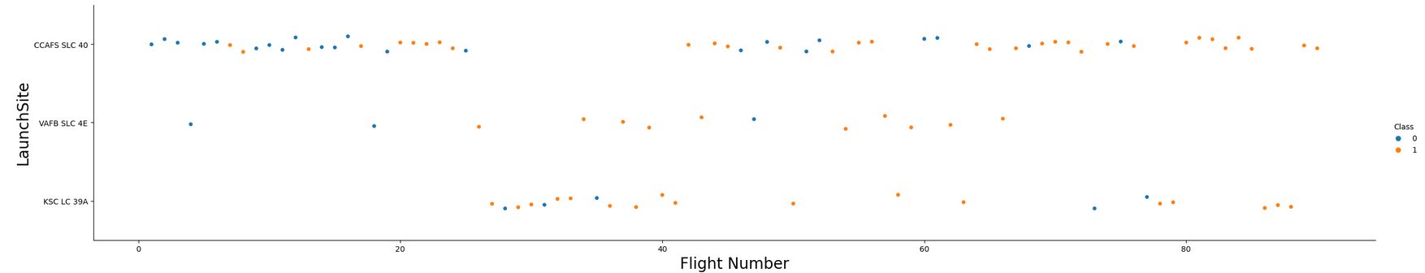
Flight Number vs. Launch Site
For CCAFS SLC 40 the pattern suggests that the likelihood of a successful landing has increased over time or as experience with more flights has been gained. This trend might indicate an improvement in technology, operational procedures, or experience gained with each subsequent flight.

Slide 19
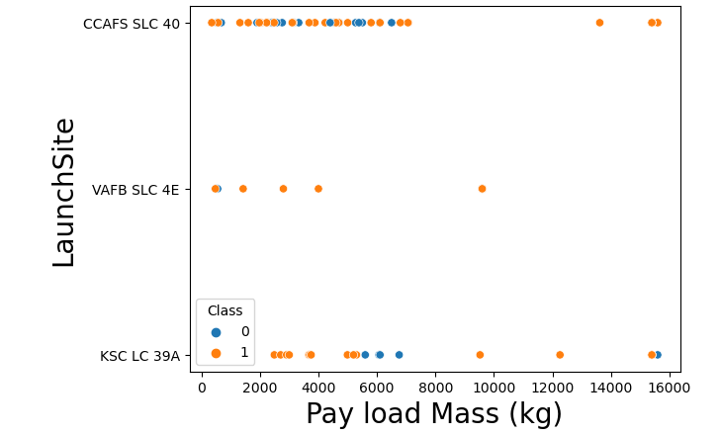
Payload vs. Launch Site
From the VAFB-SLC launchsite there are no rockets launched for heavypayload mass(greater than 10000). The most succesful were launches form VAFB-SLC launchsite where payload mass wasn't greater that 10000.

Slide 20
Success Rate vs. Orbit Type
From the plot, we can see that ES-L1, GEO, HEO, SSO, VLEO had the most success rate.

Slide 21
Flight Number vs. Orbit Type
The plot doesn’t show any relations between flight number and orbit type

Slide 22
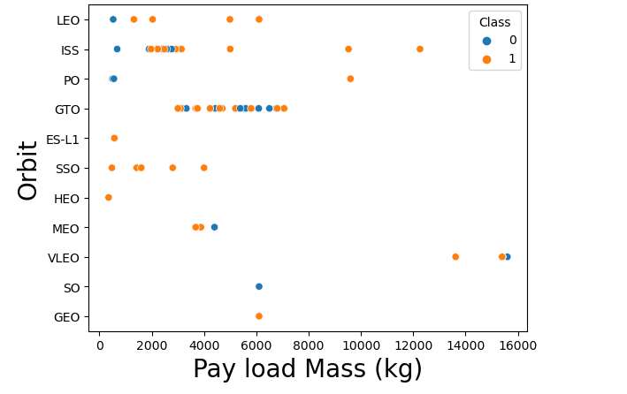
Payload vs. Orbit Type
With heavy payload the most successful site in ISS, then LEO and Polar.

Slide 23
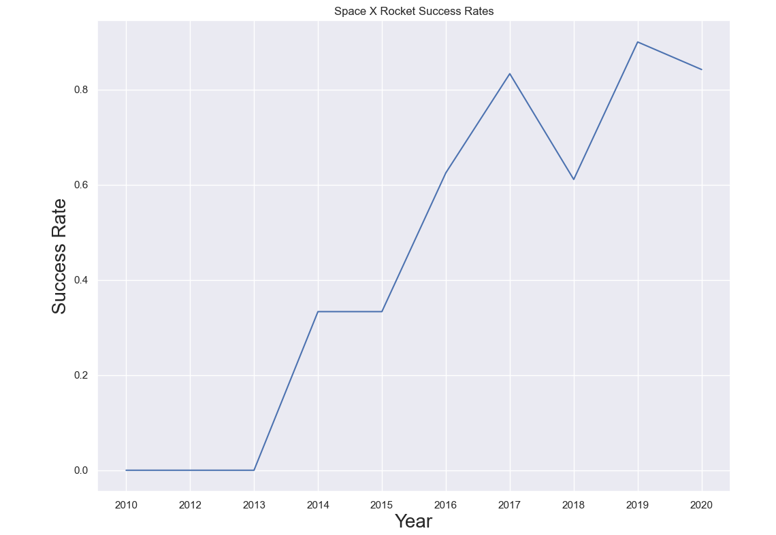
Launch Success Yearly Trend
From the plot, we can observe that success rate since 2013 kept on increasing till 2020.

Slide 24
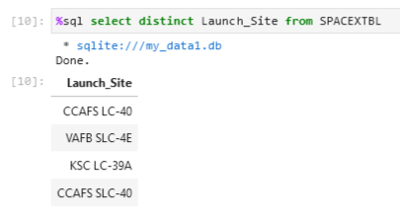
All Launch Site Names
Key word DISTINCT used to show only unique launch sites from the SpaceX data.

Slide 25
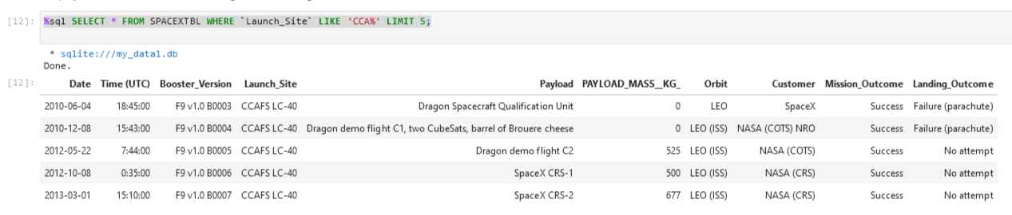
Launch Site Names Begin with 'CCA'
The query below used to display 5 records where launch sites begin with `CCA`

Slide 26
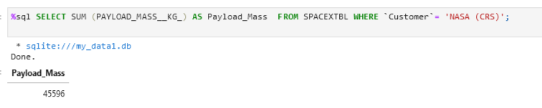
Total Payload Mass
The total payload carried by boosters from NASA is 45596. It was calculated using the query below

Slide 27
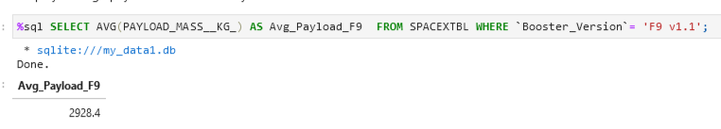
Average Payload Mass by F9 v1.1
Average payload mass carried by booster version F9 v1.1 is 2928.4

Slide 28
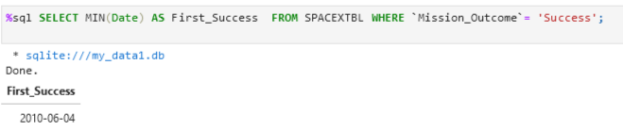
First Successful Ground Landing Date
Using the query below we calculated when the first successful landing outcome in ground pad was achieved.

Slide 29
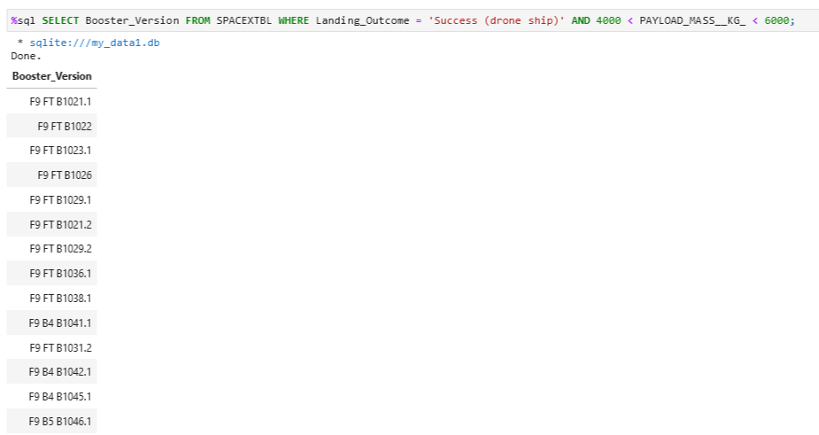
Successful Drone Ship Landing with Payload between 4000 and 6000
The names of the boosters which have success in drone ship and have payload mass greater than 4000 but less than 6000

Slide 30
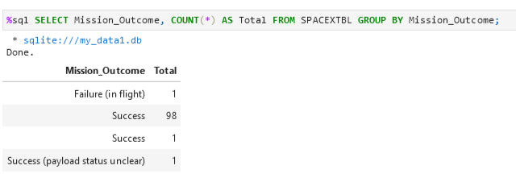
Total Number of Successful and Failure Mission Outcomes
The total number of successful and failure mission outcomes

Slide 31
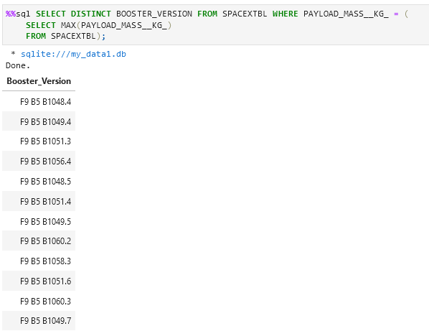
Boosters Carried Maximum Payload
The names of the booster versions which have carried the maximum payload mass

Slide 32
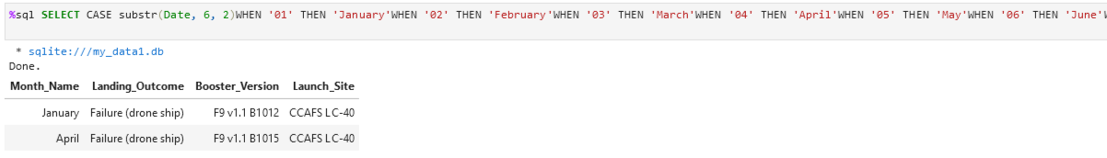
2015 Launch Records
This records displays the month names, failure landing_outcomes in drone ship ,booster versions, launch_site for the months in year 2015

Slide 33
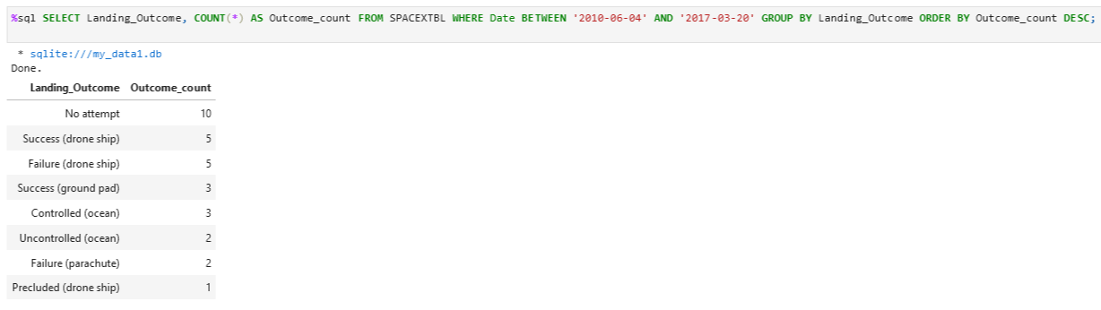
Rank Landing Outcomes Between 2010-06-04 and 2017-03-20

Slide 34

Section 3

Slide 35
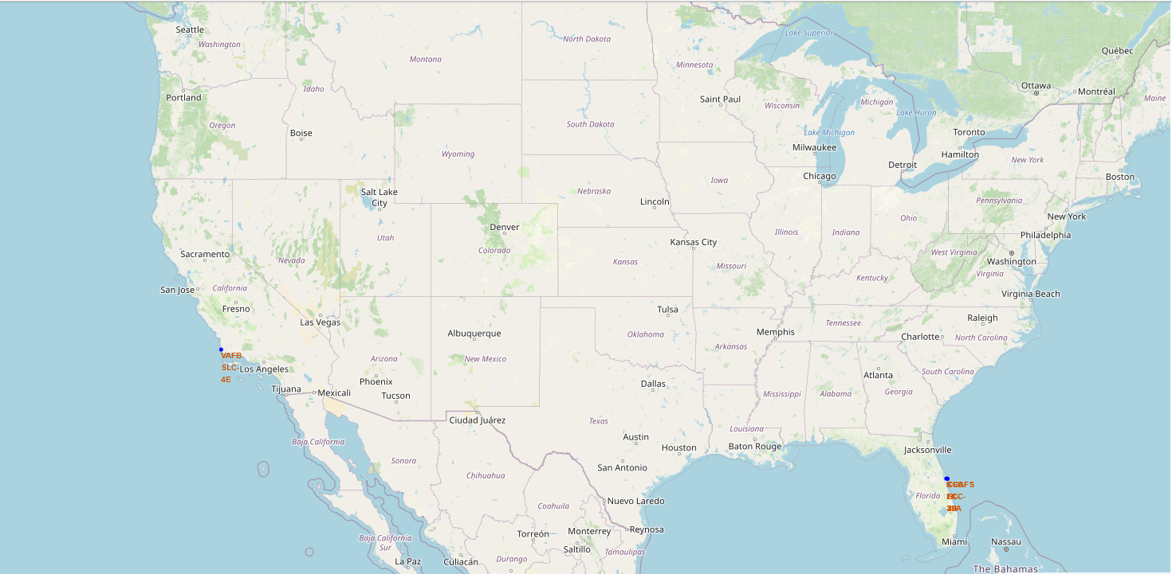
All launch sites global map markers
The map showing SpaceX launch sites with a popup label showing its name.

Slide 36
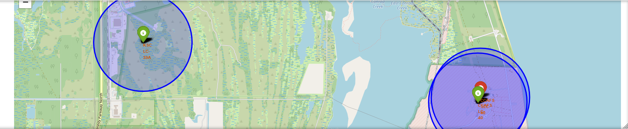
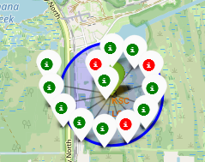
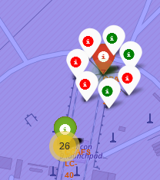
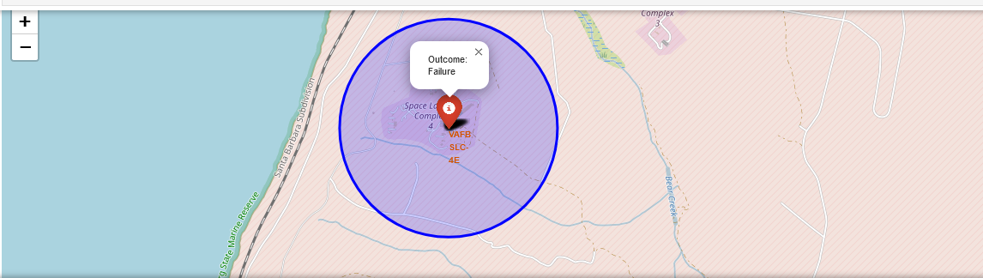
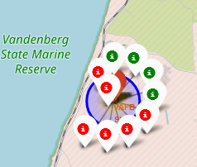
Markers showing launch sites with color labels
Florida Launch Sites
Green Markers shows successful landing
Red Markers shows failed landing
California Launch Sites

Slide 37
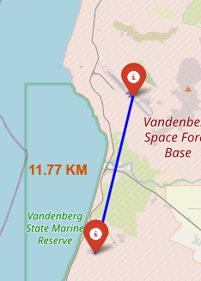
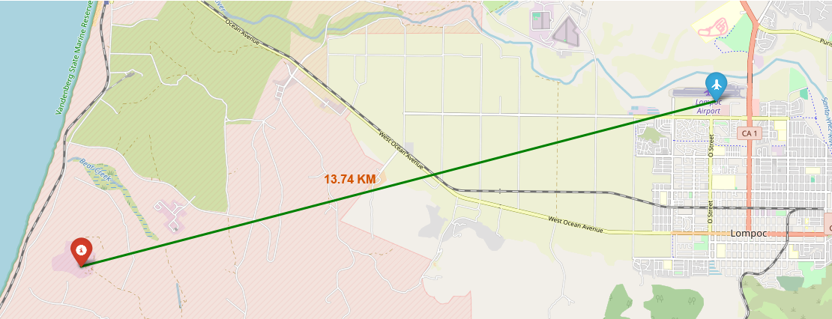
Launch Site distance to landmarks
These graphs shows the distance to the closest airports. This knowledge crucial for the launch sites

Slide 38

Section 4

Slide 39
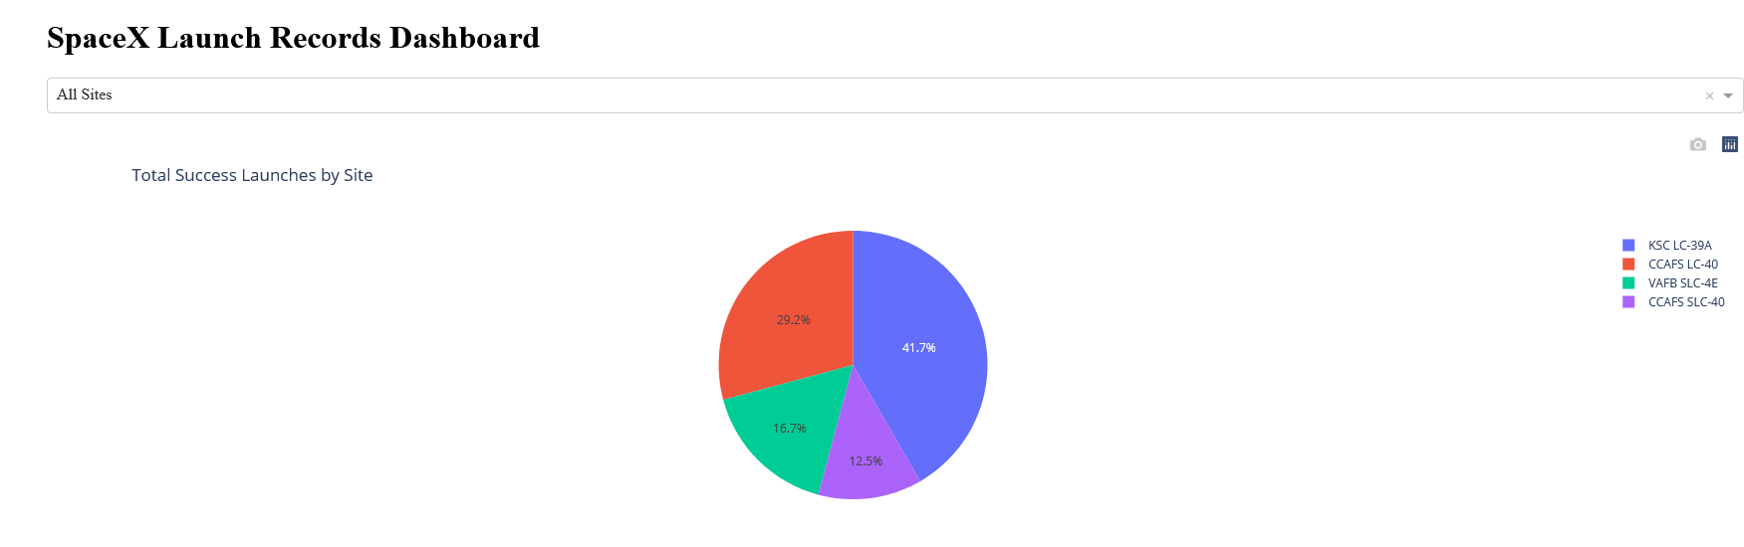
Pie chart showing the success percentage achieved by each launch site
This chart shows that KSC LC-39A had the most successful launches and CCAPS SLC-40 the least successful.

Slide 40
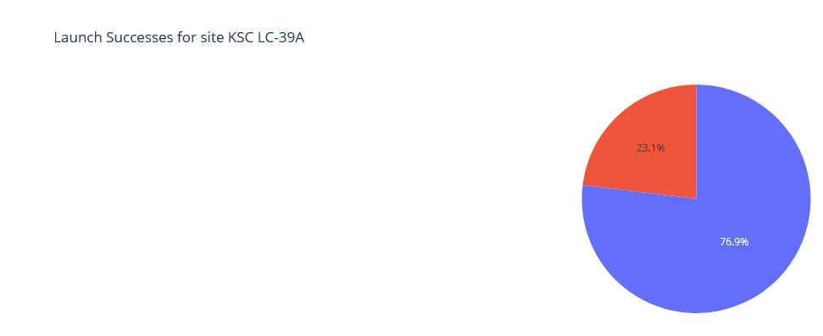
Pie chart showing the Launch site with the highest launch success ratio

Slide 41
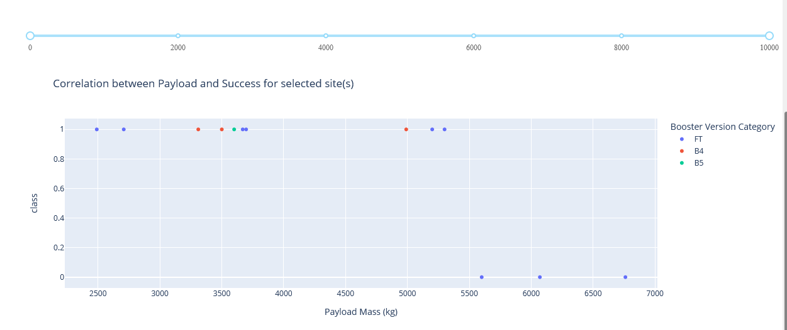
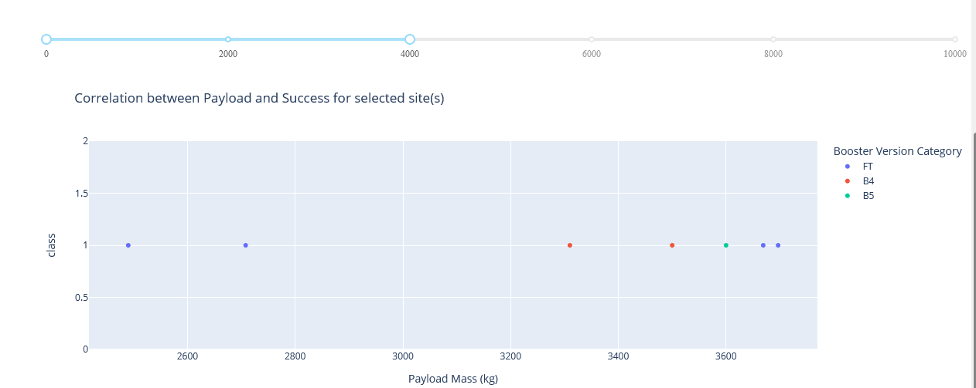
Scatter plot of Payload vs Launch Outcome for all sites, with different payload selected in the range slider
High weight payload
Low weight payload

Slide 42

Section 5

Slide 43
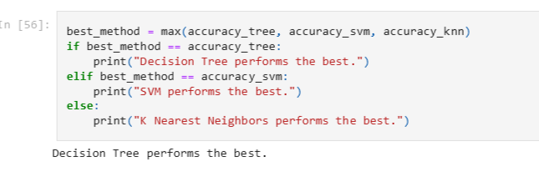
Classification Accuracy
The decision tree classifier is the model with the highest classification accuracy

Slide 44
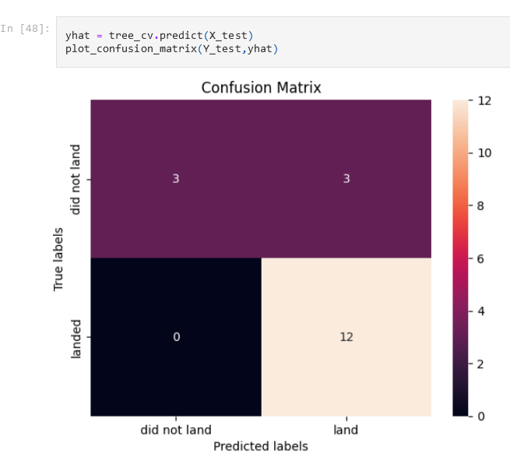
Confusion Matrix
The confusion matrix for the decision tree classifier shows that the classifier can distinguish between the different classes. The major problem is the false positives .i.e., unsuccessful landing marked as successful landing by the classifier.

Slide 45
Conclusions
• The larger the flight amount at a launch site, the greater the success rate at a launch site.
• Launch success rate started to increase in 2013 till 2020.
• Orbits ES-L1, GEO, HEO, SSO, VLEO had the most success rate.
• KSC LC-39A had the most successful launches of any sites.
• The Decision tree classifier is the best machine learning algorithm for this task.

Slide 46


